Slide 1
Object-Oriented Analysis and Design

Slide 2
OOAD
Software development is dynamic process.
It always undergoes major changes.
Vast number of Tools & Methodologies are available for systems development.
Systems Development refers to all activities that goes into producing an information systems solution.

Slide 3
A Software development methodology is a series of processes that, if followed can lead to the development of an application.
Systems development consists of:
  Analysis
  Design
  Modeling
  Implementation
  Testing & Maintenance

Slide 4
OOAD Methodology:
  Views software in the form of objects which are discrete and grouped.
  OOSD focuses on the object, which combines data and functionality .
  Primary focus is on data.
  Data security is given utmost attention.
  OOSD is a way to develop software by building self-contained modules or objects that can be easily replaced, modified and reused.
  OOSD encourages views of the world as a system of cooperative and collaborating objects.
Traditional Development Technique:
  Views software as collection of programs or functions and isolated data.
  Algorithm + Data Structure = Program
  It focuses on the functions of the system – What is it doing ? Primary focus is on function.
  Data is free flowing.

Slide 5
In an O-O environment software is a collection of discrete objects that encapsulate their data as well as the functionality, to model real-world entity.
In an O-O system everything is an object and each object is responsible for itself.
Why an Object Orientation ?
O-O systems are :
  Easier to adapt to changing requirements.
  Easier to maintain More robust & promote greater design & Code reuse
Reasons why object orientation works:
  Higher level of abstraction. (At object level)
  Seamless transition among different phases of software development.
  O-O uses same language like UML(Unified Modeling Language) to talk about all phases of software development.
  It reduces complexity, redundancy, & creating a robust system.
  Encouragement of good programming technique. & Promotion of reusability.

Slide 6
UNIFIED APPROACH
The Unified Approach(UA) is a methodology for software development.
The UA is based on methodologies by Grady Booch, Rumbaugh & Jacobson, tries to combine the best practices, processes & guidelines along with OMG’s (Object Management Group’s) UML.

Slide 7
Thinking in Objects and UML - 1
The Unified Modeling Language (UML) is a standard diagramming notation; sometimes referred to as a blueprint.
It is NOT OOA/OOD or a method
Only a notation for capturing objects and the relationships among objects (dependency; inheritance; realizes; aggregates, . .)
UML is language-independent
Analysis and design provide software “blueprints” captured in UML.
Blueprints serve as a tool for thought and as a form of communication with others.

Slide 8
Thinking in Objects and UML – 2
But it is far more essential to ‘think’ in terms of objects as providing ‘services’ and accommodating ‘responsibilities.’
Discuss: What is meant by ‘services?’ How indicated?
  How might you think these ‘services’ impact the design of classes?
  How might a client access these services?
  What is encapsulation? How does it relate to reusability? Self-governance? Design?
Discuss: What is meant by ‘responsibilities?’
  Encapsulation of data and services?

Slide 9
Thinking in Terms of Objects and UML - 3
Object-Oriented Analysis (Overview)
  An investigation of the problem (rather than how a solution is defined)
  During OO analysis, there is an emphasis on finding and describing the objects (or concepts) in the problem domain.
  For example, concepts in a Library Information System include Book, and Library.
  High level views found in the application domain.
  Oftentimes called domain objects; entities.

Slide 10
Thinking in Terms of Objects and UML - 4
Object-Oriented Design
  Emphasizes a conceptual solution that fulfills the requirements.
  Need to define software objects and how they collaborate to meet the requirements.
  For example, in the Library Information System, a Book software object may have a title attribute and a getChapter method.
    What are the methods needed to process the attributes?
Designs are implemented in a programming language.
  In the example, we will have a Book class in Java.

Slide 11
Thinking in Terms of Objects and UML – 5
From Design to Implementation
Analysis
investigation
of the problem
Design
logical solution
Construction
code
Book
public class Book {
  public void print();
  private String title;
}
Book
(concept)
title
print()
Domain concept
Representation in
analysis of concepts
Representation in an
object-oriented
programming language.
Can you see the services / responsibilities in the Book class?

Slide 12
Thinking in Objects and UML-6
Then too, there are sets of proven design solutions to problems that are considered ‘best practices.’
  Certain ‘groupings’ of classes with specific responsibilities / interfaces.
  These provide specific solutions to specific problems.
  Called Design Patterns
We will discuss (much later) these standard patterns and how to apply them to develop solutions to common design problems.

Slide 13
Thinking in Objects and UML-7
Of course, design (solution to requirements) ‘assume’ a robust requirements analysis has taken place.
Use Cases are often used to capture stories of requirements and are often views as ‘constituting’ the functional requirements, but NOT the software quality factors (non-functional requirements).
Use Cases are not specifically designed to be object-oriented, but rather are meant to capture how an application will be used.
Many methods for capturing requirements.
We will concentrate on Use Cases (ahead).

Slide 14
Basic Terms: Iterative, Evolutionary, and Agile
1. Introduction
Iterative - the entire project will be composed of min-projects and will iterate the same activities again and again (but on different part of the project AND with different emphases) until completion.
Evolutionary (or incremental) - the software grows by increments (to be opposed to the traditional, and somewhat old-fashioned, Waterfall model of software development).
Agile - we will use a light approach to software development rather than a very rigid one (which may be needed for a safety-critical system for example)
This kind of approach seems better at treating software development as a problem solving activity; also the use of objects makes it amenable.
Notes:
Explain Iterative, Evolutionary, Agile

Slide 15
Our Approach:
We need a Requirements Analysis approach with OOA/OOD need to be practiced in a framework of a development process.
We will adopt an agile approach (light weight, flexible) in the context of the Unified Process, which can be used as a sample iterative development process.
  Within this process, the principles can be discussed.
Please note that there are several other contexts that may be used, such as Scrum, XP, Feature-Driven Development, Lean Development, Crystal Methods and others…and we will look at a few of these.
Notes:
why do you think it works better this way for software?

Slide 16
Why the Unified Process:
The Unified Process is a popular iterative software development process.
Iterative and evolutionary development involves relatively early programming and testing of a partial system, in repeated cycles.
It typically also means that development starts before the exact software requirements have been specified in detail;
Feedback (based on measurement) is used to clarify, correct and improve the evolving specification:
This is in complete contrast to what we usually mean by engineering!
Notes:
why do you think it works better this way for software?

Slide 17
2. What is the Unified Process?
The UP is very flexible and open and can include other practices from other methods such as Extreme Programming (XP) or Scrum for example.
  e.g. XP’s test-driven development, refactoring can fit within a UP project; So can Scrum’s daily meeting.

Slide 18
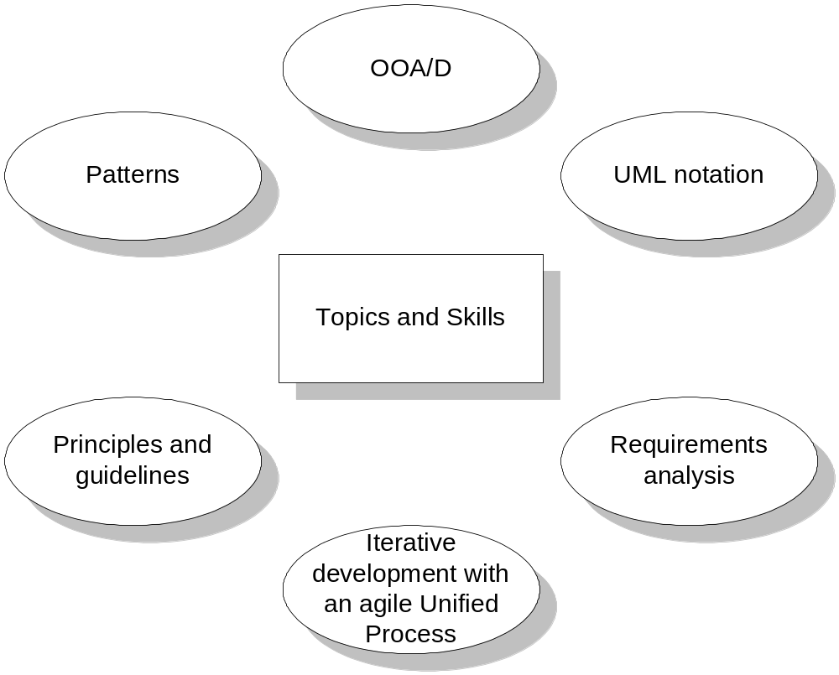
We will be studying all of the topics found in Fig. 1.1

Slide 19
What is Object-Oriented Analysis and Design
OOAD – represents evolutionary development not revolutionary.
OOA: examines requirements from the perspective of classes and objects found in the vocabulary of the problem domain.
we find and describe business objects or concepts in the problem domain
  Identifying objects
  Identifying structures
  Identifying attributes
  Identifying associations
  identifying services
  Requirements OOA Objects/Attribute/Associations

Slide 20
OOD: designing with OO decomposition.
Different notations used:
  Logical model (class and object structure)
  Physical model (module and process architecture)
  Behavioral model (static and dynamics of the system)
OOD Stages:
  Definition of the context of the system
  Designing system architecture
  Identification of the objects in the system
  Construction of design models
  Specification of object interfaces
we define how these software objects collaborate to meet the requirements.
  Attributes and methods.
  Builds on the output of OOA

Slide 21
OOP: is a programming language model organized around objects rather than actions and data rather than logic.
Three important parts of OOP:
  Object
  Class(Type)
  Inheritance
Implementation: we implement the design objects in, say, Java, C++, C#, etc.

Slide 22
Relation b/w OOA, OOD and OOP
OOA : concerned with developing a object model that capture the requirements.
OOD: concerned with translating OOA model into a specific model that can be implemented by a software.
OOP: concerned with realizing the OOD model using OOP language such as Java, C++ etc.
Real world objects
Software
OOA
OOD
OOP

